Slide 1
Health Governance in South Africa
1986: WHO declared District Health System (DHS) as most appropriate vehicle for delivery of primary health care
All health care services for well-defined population in delineated geographical area
1994: African National Congress (ANC) Health Plan
Decentralize services to lowest level possible through DHS
Overcome fragmented/inequitable health services from apartheid
1996: Post-apartheid Constitution
Established three autonomous spheres of government: national, provincial, local
Each with set of constitutionally protected powers
Inalienable rights to health for all South Africans, regardless of race
National and provincial government responsible for “health services”
Local government responsible for “municipal health services”

Slide 2
Health Governance in South Africa
2003: National Health Act
Adopted DHS as basis for Unified National Health System of South Africa
Divided country into geographically defined health districts
Formalized responsibility for primary health care to provincial government
Could be assigned to municipalities if have capacity and willingness

Slide 3
Health Governance in South Africa
National level health service responsibilities
Provide overall strategic direction for health system
Ensure health policy translated into legislation
Monitor implementation and progress of national policy
Develop coordinated information systems
Build capacity of provincial/municipal health departments
Provincial level health service responsibilities
Oversee all health services within the province
Provide regional and specialized hospital & emergency services
Plan and manage provincial health information system
Develop provincial health policies, norms, standards and legislation
Coordinate funding and financial management of district health services
Provide and maintain equipment, vehicles, and health care facilities

Slide 4
Health Governance in South Africa
District Health System health service responsibilities
Ensure health promotion services
Ensure availability of full range of primary health care and other relevant health services in communities, clinics, community health centers, district hospitals*
Ensure promotion and maintenance of environmental hygiene; i.e. sanitation, housing, noise, food and occupational hygiene, identification and control of local health hazards
Ensure provision of essential health support services including: facilities, essential medicines, essential diagnostic services, transport and maintenance of equipment
Monitor and evaluate health service provision
*Note: this package subject to the outcome of negotiations between the province and municipality in terms of the constitutional right of municipalities to render municipal health services

Slide 5
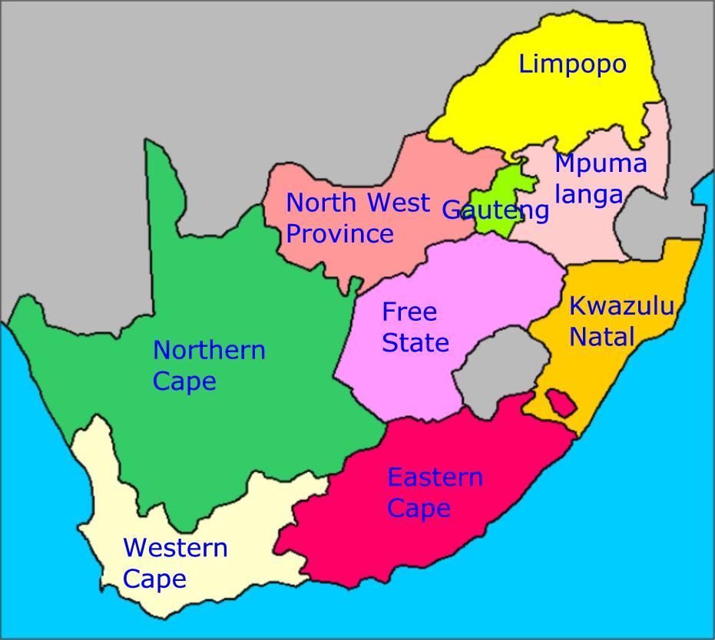
Health Governance in South Africa
9 provinces, 278 municipalities

Slide 6
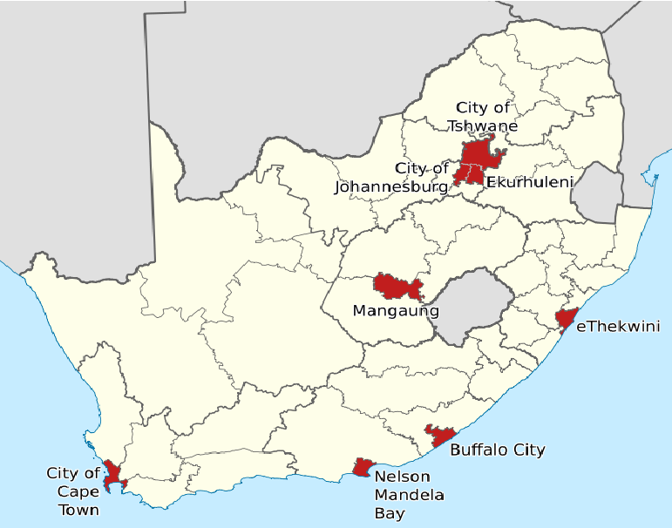
Health Governance in South Africa
9 provinces, 278 municipalities
8 Metropolitan Municipalities (Category A)
Exclusive municipal executive and legislative authority in its area
Buffalo City (East London)
City of Cape Town
City of Johannesburg
City of Tshwane (Pretoria)
Ekurhuleni (East Rand)
eThekwini (Durban)
Mangaung (Bloemfontein)
Nelson Mandela Bay (Port Elizabeth)

Slide 7
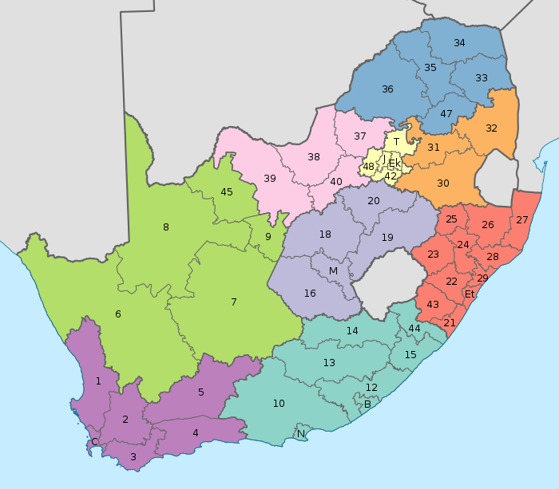
Health Governance in South Africa
9 provinces, 278 municipalities
8 Metropolitan Municipalities (Category A)
Exclusive municipal executive and legislative authority in its area
Buffalo City (East London)
City of Cape Town
City of Johannesburg
City of Tshwane (Pretoria)
Ekurhuleni (East Rand)
eThekwini (Durban)
Mangaung (Bloemfontein)
Nelson Mandela Bay (Port Elizabeth)
52 District Municipalities (Category C)
Executive and legislative authority in an area that includes more than one municipality

Slide 8
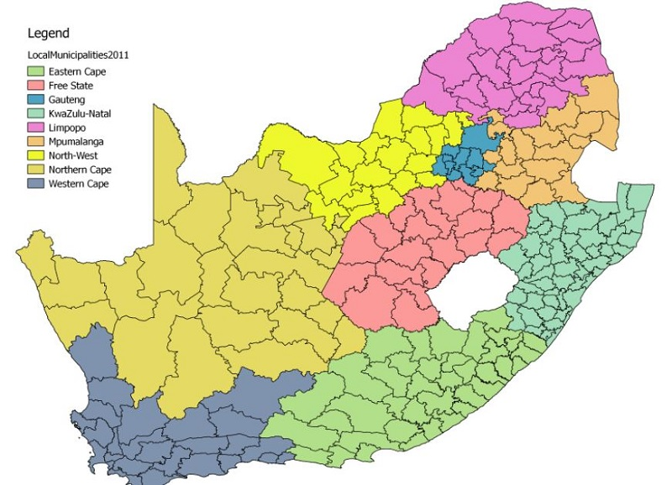
Health Governance in South Africa
9 provinces, 278 municipalities
8 Metropolitan Municipalities (Category A)
Exclusive municipal executive and legislative authority in its area
Buffalo City (East London)
City of Cape Town
City of Johannesburg
City of Tshwane (Pretoria)
Ekurhuleni (East Rand)
eThekwini (Durban)
Mangaung (Bloemfontein)
Nelson Mandela Bay (Port Elizabeth)
52 District Municipalities (Category C)
Executive and legislative authority in an area that includes more than one municipality
226 Local Municipalities (Category B)
Share municipal executive and legislative authority with a Category C municipality, within whose area they fall

Slide 9
Health Governance in South Africa
“Quasi-federal system of government”
Three concurrent health systems: National, Provincial, Local Health Systems, each with legislative/executive authority in their own spheres
Administrative, financial and support services, planning and human resources provided through negotiated agreements between province, districts, and municipalities
Many challenges
Poor coordination of policy implementation between three spheres
Limited delegation of powers by provinces to district and facility health management
Weak management, accountability and support
Poor financial management, inefficient patient information systems, inefficient drug supply and management systems at sub-national levels

Slide 10
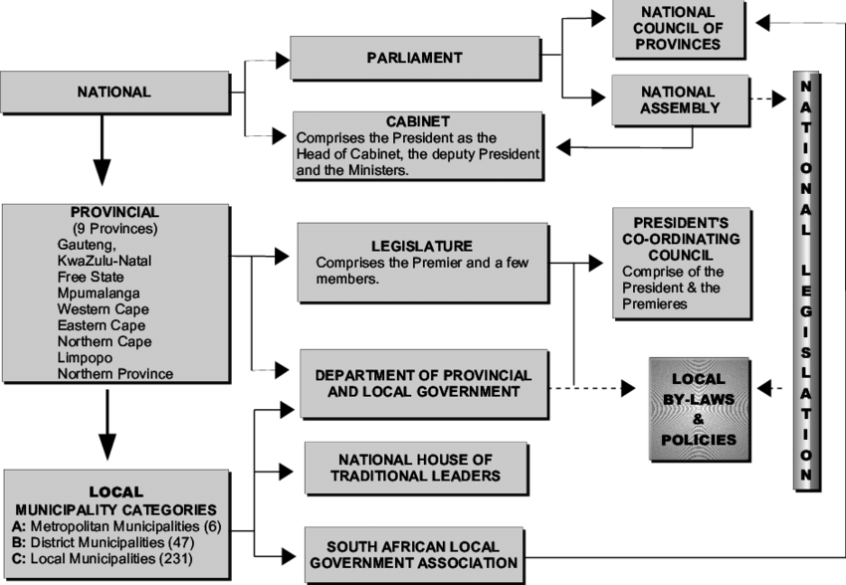
South African Political Structure

Slide 11
Health Governance in South Africa
Sphere
Revenue Source
National
National Tax Revenue
Levy on medical schemes (insurance)
Contributions from households and tax subsidies
Minister of Health
National Department of Health
Director General
National Health Laboratory Service
National policy parameters
HIV/AIDS, TB, Maternal Child Health
Deputy Director-General
Pays for services
Provincial
Provincial grants
Conditional grants
Own revenue
Provincial Department of Health
Provincial policy parameters
Provincial clinics - hospital, emergency, and ambulatory care
17 Provincial Tertiary, 42 Regional,
199 District Laboratories
Local
Local grants
Conditional provincial transfers
Own revenue
District Management Team
District Laboratories
Municipal clinics - limited ambulatory/emergency services provided directly or in relationship with provincial govt

Slide 12
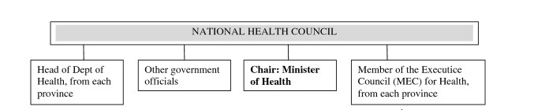
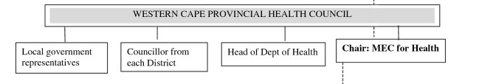
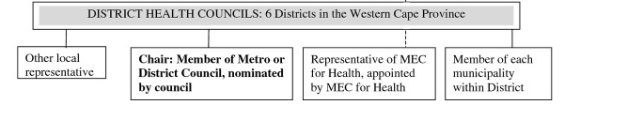
But wait, there’s more
Sphere
National
Provincial
Local

Slide 13
Who is responsible for fixing “above site” issues?
Sphere
National
Minister of Health
National Department of Health
Director General
National Health Laboratory Service
National policy parameters
HIV/AIDS, TB, Maternal Child Health
Deputy Director-General
Issue
Space issues at facility – want Park Home placed on premises
Pays for services
Provincial
Provincial Department of Health
Provincial policy parameters
Provincial clinics - hospital, emergency, and ambulatory care
17 Provincial Tertiary, 42 Regional,
199 District Laboratories
Plus: District/city zoning boards, District/City environmental requirements
Local
District Management Team
District Laboratories
Municipal clinics - limited ambulatory/emergency services provided directly or in relationship with provincial govt

Slide 14
Who is responsible for fixing “above site” issues?
Sphere
National
Minister of Health
National Department of Health
Director General
National Health Laboratory Service
National policy parameters
HIV/AIDS, TB, Maternal Child Health
Deputy Director-General
Issue
No filing cabinets
Pays for services
Provincial
Provincial Department of Health
Provincial policy parameters
Provincial clinics - hospital, emergency, and ambulatory care
17 Provincial Tertiary, 42 Regional,
199 District Laboratories
Local
District Management Team
District Laboratories
Municipal clinics - limited ambulatory/emergency services provided directly or in relationship with provincial govt

Slide 15
Who is responsible for fixing “above site” issues?
Sphere
National
Minister of Health
National Department of Health
Director General
National Health Laboratory Service
Health Information Management and Monitoring and Evaluation Cluster
National policy parameters
HIV/AIDS, TB, Maternal Child Health
Deputy Director-General
Issue
TIER.net is not functional
Pays for services
Provincial
Provincial Department of Health
Provincial policy parameters
Provincial clinics - hospital, emergency, and ambulatory care
17 Provincial Tertiary, 42 Regional,
199 District Laboratories
Local
District Management Team
District Laboratories
Municipal clinics - limited ambulatory/emergency services provided directly or in relationship with provincial govt

Slide 16
Who is responsible for fixing “above site” issues?
Sphere
National
Minister of Health
National Department of Health
Director General
National Health Laboratory Service
National policy parameters
HIV/AIDS, TB, Maternal Child Health
Deputy Director-General
Issue
Facilities won’t implement extended hours or weekend hours
Pays for services
Provincial
Provincial Department of Health
Provincial policy parameters
Provincial clinics - hospital, emergency, and ambulatory care
17 Provincial Tertiary, 42 Regional,
199 District Laboratories
Plus: Unions
Local
District Management Team
District Laboratories
Municipal clinics - limited ambulatory/emergency services provided directly or in relationship with provincial govt

Slide 17
Who is responsible for fixing “above site” issues?
Sphere
National
Minister of Health
National Department of Health
Director General
National Health Laboratory Service
National policy parameters
HIV/AIDS, TB, Maternal Child Health
Deputy Director-General
Issue
DoH lay counselors not meeting targets
Pays for services
Provincial
Executive Council of Province
(cabinet of provincial government)
Premier
Members of Executive Council (MEC)
Provincial Department of Health
Provincial policy parameters
Provincial clinics - hospital, emergency, and ambulatory care
17 Provincial Tertiary, 42 Regional,
199 District Laboratories
Plus: Organization that is subcontracted by NDoH to hire counselors
Local
District Management Team
District Laboratories
Municipal clinics - limited ambulatory/emergency services provided directly or in relationship with provincial govt

Slide 18
CDC Direct Service Partners (DSP)
Cooperative Agreements (CoAg)
ASSISTANCE – CDC financially supports a program to accomplish a public purpose
As opposed to a contract, which is an ACQUISITION where CDC is a buyer of a service
As opposed to research, where CDC can dictate precise rules, roles, timelines, processes
Requires substantial CDC involvement in program implementation
Budget, scope, reporting governed by pre-negotiated terms of the CoAg
Aurum
Health Systems Trust
TB/HIV Care
Wits Reproductive Health & HIV Institute

Slide 19
CDC Direct Service Partners
What DSPs can do for Siyenza | What DSPs can’t do for Siyenza
Develop relationships with district & municipal health leadership | Change/develop district/municipal health policy, rules, or processes
Provide additional human resources in health facilities* | Ensure adequate DoH staff at facility
Train DSP and health facility staff | Hold health facility staff accountable
Provide equipment, materials, supplies* | Ensure district/municipality provides equipment, materials, supplies, forms, registers
Support health facility staff | Supervise DoH staff
*Significant monetary/programmatic decisions must already be in the DSP’s approved work plan, otherwise require approval (and usually lots of paperwork) by CDC project officer and extramural office

Slide 20
CDC and Siyenza
Minister of Health
CDC
National Health Laboratory Service
National Department of Health
Direct Support Partners (DSP) Staff: Chief of Party, QI teams, SI teams, Community teams
HIV/AIDS, TB, Maternal Child Health
17 Provincial Tertiary, 42 Regional,
199 District Laboratories
Provincial Department of Health
District Coordinator & Sub-district coordinator
238 Community Health Clinics (CHCs) - provincial clinic services plus 24-hour maternity service, emergency care & short stay ward
Site Lead
Facility-based direct service delivery (DSD) staff
3,074 Provincial Clinics
District Laboratories
Municipal jurisdiction
Ekhuruleni – 74 clinics
eThekwini – 59 clinics
City of Tshwane – 25 clinics
Johannesburg – X clinics
Cape Town – X clinics
Facility-based direct service delivery (DSD) staff

Slide 21
Health Facility Staff
Health Facility Staff
DSP DSD Staff
Role
Facility Manager
Site Lead
Senior nurse, oversees clinical/administrative services
Professional Nurse-NIMART*
Professional Nurse-NIMART*
Patient clinical care, initiate ART
Professional Nurse
Patient clinical care
Midwife
Pregnant women, deliveries
Enrolled Nurse
Enrolled Nurse
Limited nursing care
Nursing Auxillary
Basic procedures
Administrative Clerk
Administrative Clerk
Register patients, pulls files, appointments
Pharmacist/Pharmacy Asst
Provide medication to patients; pharmacy open M-F 8-4:30
Data capturer
Data capturer
Capture/enter patient data into databases
Linkage officer
Ensure linkage to care (initiation) and retention
Adherence club facilitator
Facilitate ART adherence clubs
Social worker
Case managers
Support, trace, track, mentor cohorts of HIV patients for 1 year
Tracer
Call patients who have missed appointments to bring back to care
Lay Counselor
Lay Counselor
HIV testing/counseling (note: counselors in facilities typically not paid by/under authority of Facility Manager – NDOH hires through contract)
*NIMART = Nurse Initiation and Management of Antiretroviral Therapy

Slide 22
Community Staff
Health Facility
DSP DSD Staff
Siyenza Activities
Ward-based Outreach Teams (WBOT)*
DSP Community Team
Community tracing, HIV testing and counseling, Index testing, treatment initiation (?), health promotion
Mobile clinics (sometimes)
Mobile clinics
Preventive care, HIV testing and counseling, treatment initiation
Community Based Organization (subcontract) (sometimes)
Community Based Organization (subcontract)
Community tracing, HIV testing and counseling, refer initiations to clinic
*Ward-based outreach teams (WBOTs)
National policy: each ward should have ≥1 primary health care outreach team with professional nurse, environmental health officer, health promoters, 6-10 community health workers
Responsible for the health of defined catchment area (electoral ward), with defined number of households and families
Tracing/tracking activities limited due to limitations of catchment area

Slide 23
Siyenza Key Interventions
Key Intervention | Indicator | Dashboard Reflection | Time to Dashboard Reflection
Provider initiated HIV counseling and testing (PICT) | ↑ HTS_TST_POS (_Extended, _Weekend) | ↑ HTS_TST_POS | Immediate
Index Testing | ↑ HTS_TST_POS | ↑ HTS_TST_POS | Immediate
Community outreach – testing | ↑ HTS_TST_POS | ↑ HTS_TST_POS | Immediate
Same day initiation on ART -Facility- or community-based | ↑ TX_NEW ↑ TX_NEW_SAMEDAY | ↑ TX_CURR_28 ↑ NET_NEW | Immediate
Tracing patients/bringing back to care -Facility- or community-based | ↓ EARLYMISSED ↓ LATEMISSED ↓ uLTFU | ↑ TX_CURR_28 ↑ NET_NEW | ~2-3 weeks
Strategies for enhanced adherence: Central Chronic Medicine Dispensing and Distribution (CCMDD), Fast Track, Adherence clubs, IACT | (maintains/improves adherence) | ↔ TX_CURR_28 | ?

Slide 24
Siyenza Key Interventions
Central Chronic Medicines Dispensing and Distribution (CCMDD)
Dispense medicines at accessible pick-up points on 1-2 monthly basis to patients with chronic conditions
HIV clinical visits every 6 months
Service providers contracted to pack treatments and deliver to collection points
SEAD
Eligible for HIV CCMDD:
>18 years old
Same treatment regimen for at least 12 months
2 consecutive viral loads undetecteable
No TB or medical conditions
No children on ART

Slide 25
Siyenza Key Interventions
Nurse Initiation and Management of Antiretroviral Therapy (NIMART)
5-day training course
6-month mentorship program
Submit portfolio of evidence to training unit
Competency assessment
Cohort Management

Slide 26
Data Element | Location | Owner | How it gets there | How we use it | Where it shows up in dashboard | Who should use it
Viral Load | LabTrak | NHLS
CD4 | LabTrak | NHLS
GenExpert | LabTrak | NHLS
HIV PCR | LabTrak | NHLS

Slide 27
Health Information Systems
Health Patient Registration System (HPRS)
System to standardize patient registration across all health facilities
Uses South African Identity Number as unique patient identifier
Creates Patient Registry and Master Patient Index
Generates patient record number
Maintains patient details
Links patient to facility
Patient lookup (patient demographic details, facility linkage, patient record number)
Record the visit (date, time, facility, purpose)
Other capabilities (not yet operational in most places)
Barcode Scanning (ID Book and Driver’s License) and Biometric reader
Print patient labels
Schedule appointments
National managing implementation with little/no support from Province/District
Only Gauteng: Ekurlenhi (15 facilities), Tshwane (49), Joburg (50), West Rand (39), Sedibeng (42)
Many challenges (see Powerpoint)

